Slide 1
ICT CLOCK-IN CLOCK-OUT DATA ANALYSIS PRESENTATION
_

Slide 2
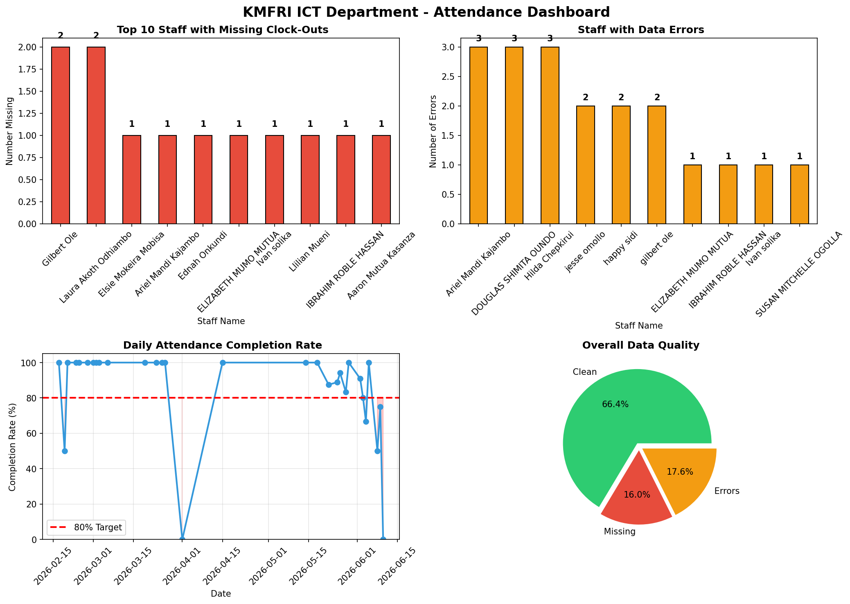
ATTENDANCE DASHBOARD

Slide 3
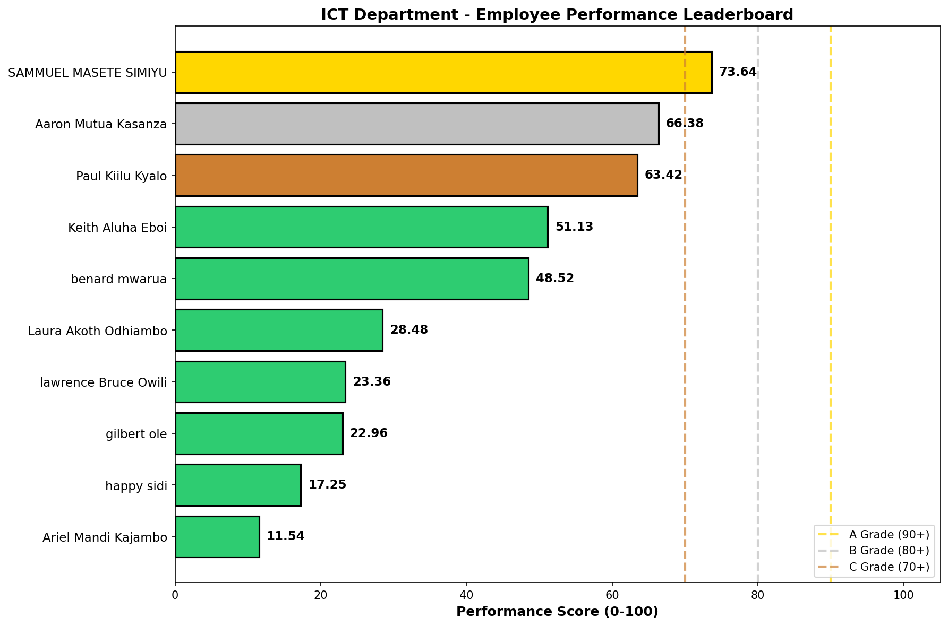
PERFORMANCE LEADERBOARD

Slide 4
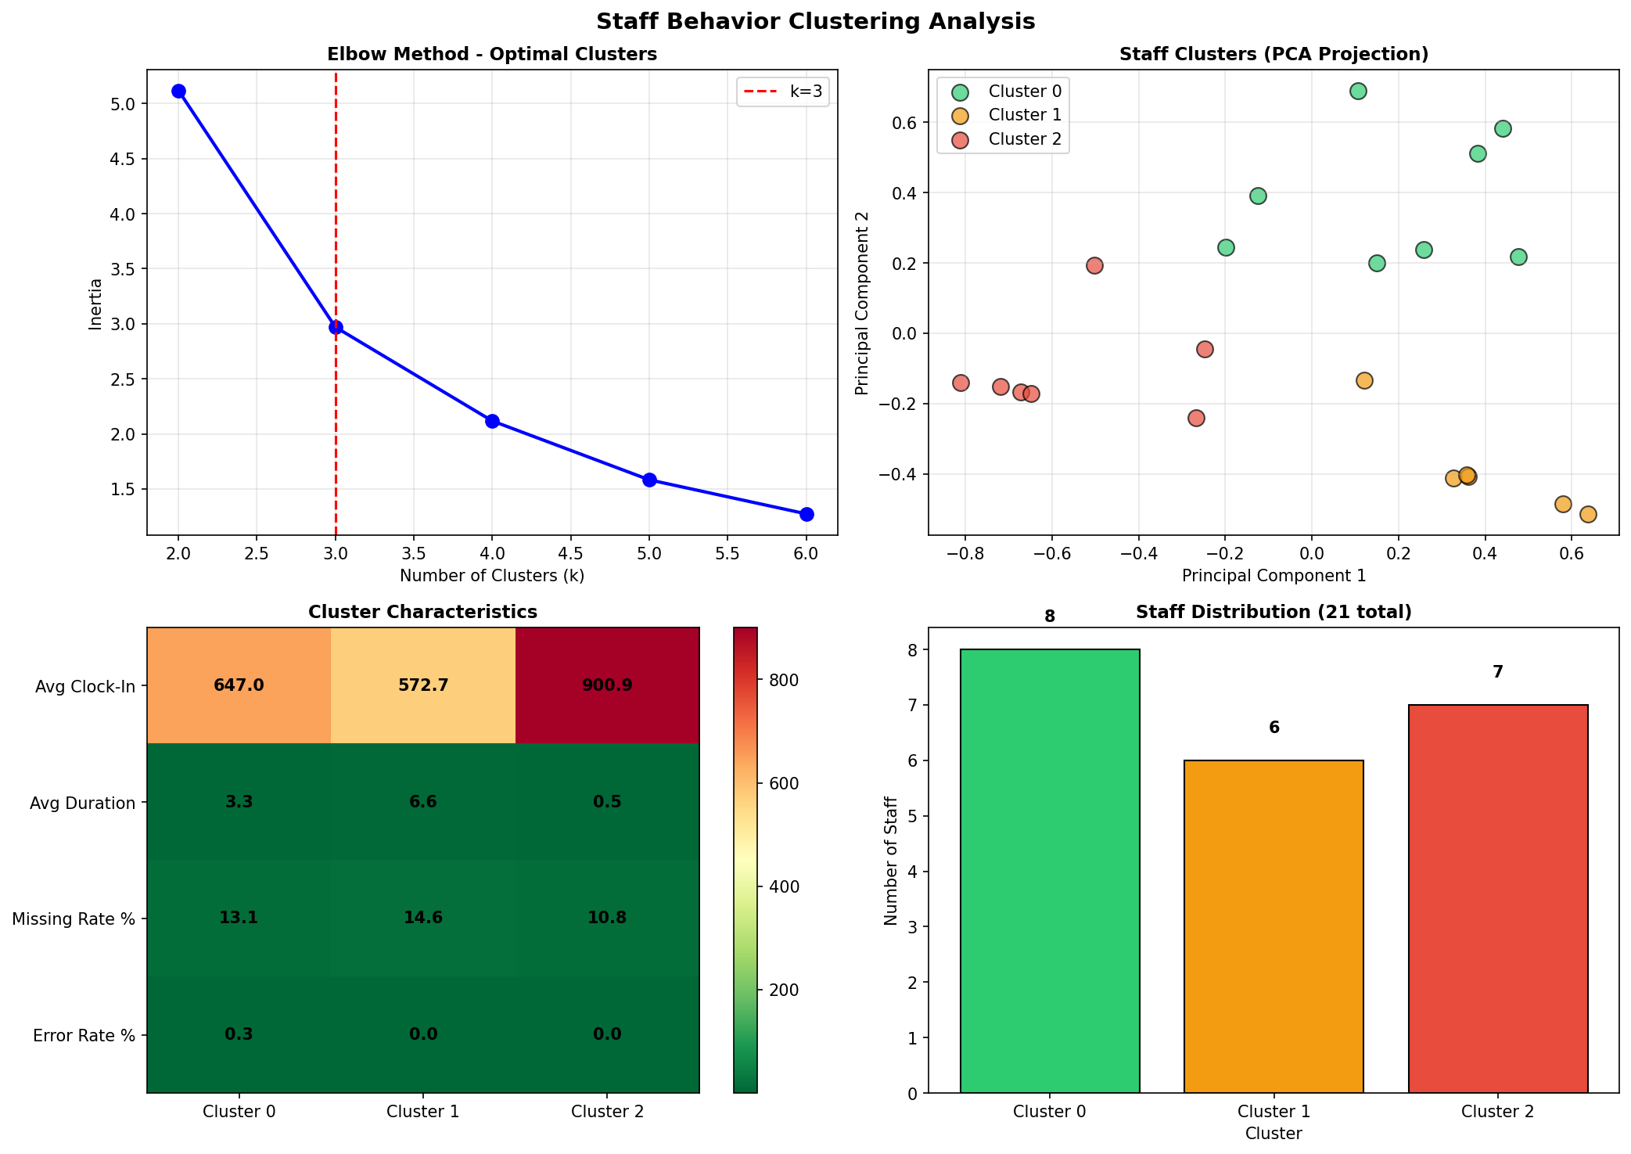
CLUSTERING ANALYSIS

Slide 5
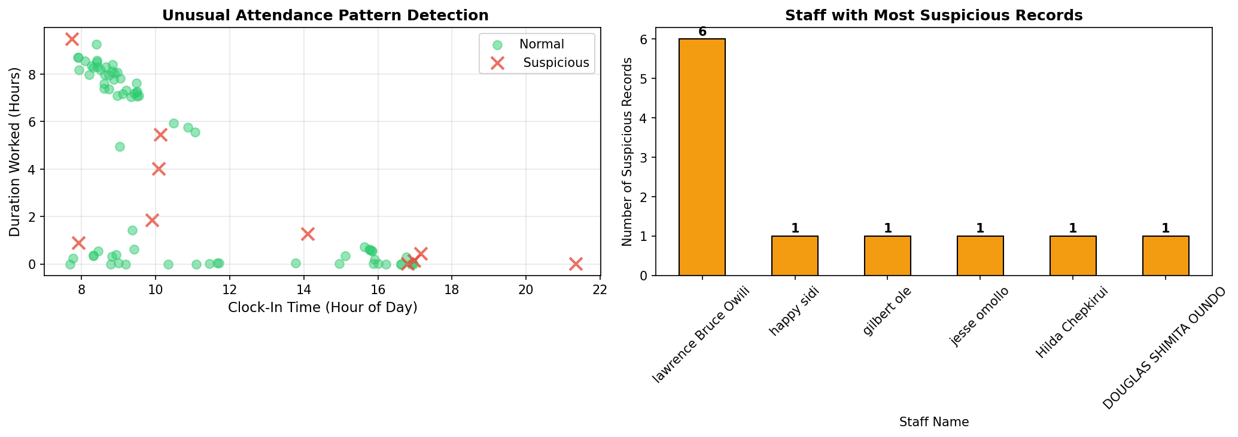
ANOMALY DETECTION

Slide 6
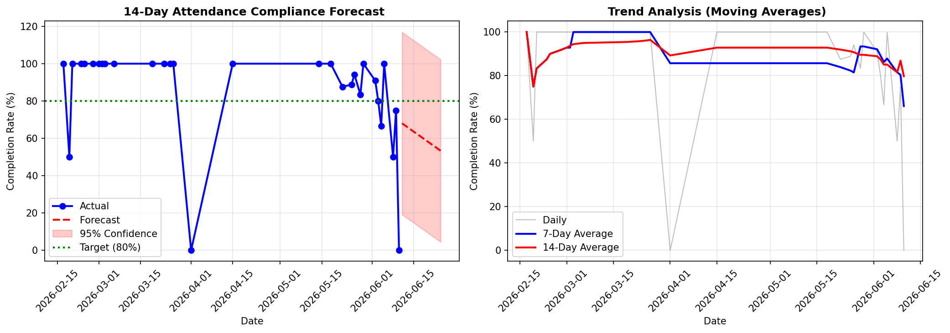
FORECAST ANALYSIS

Slide 7
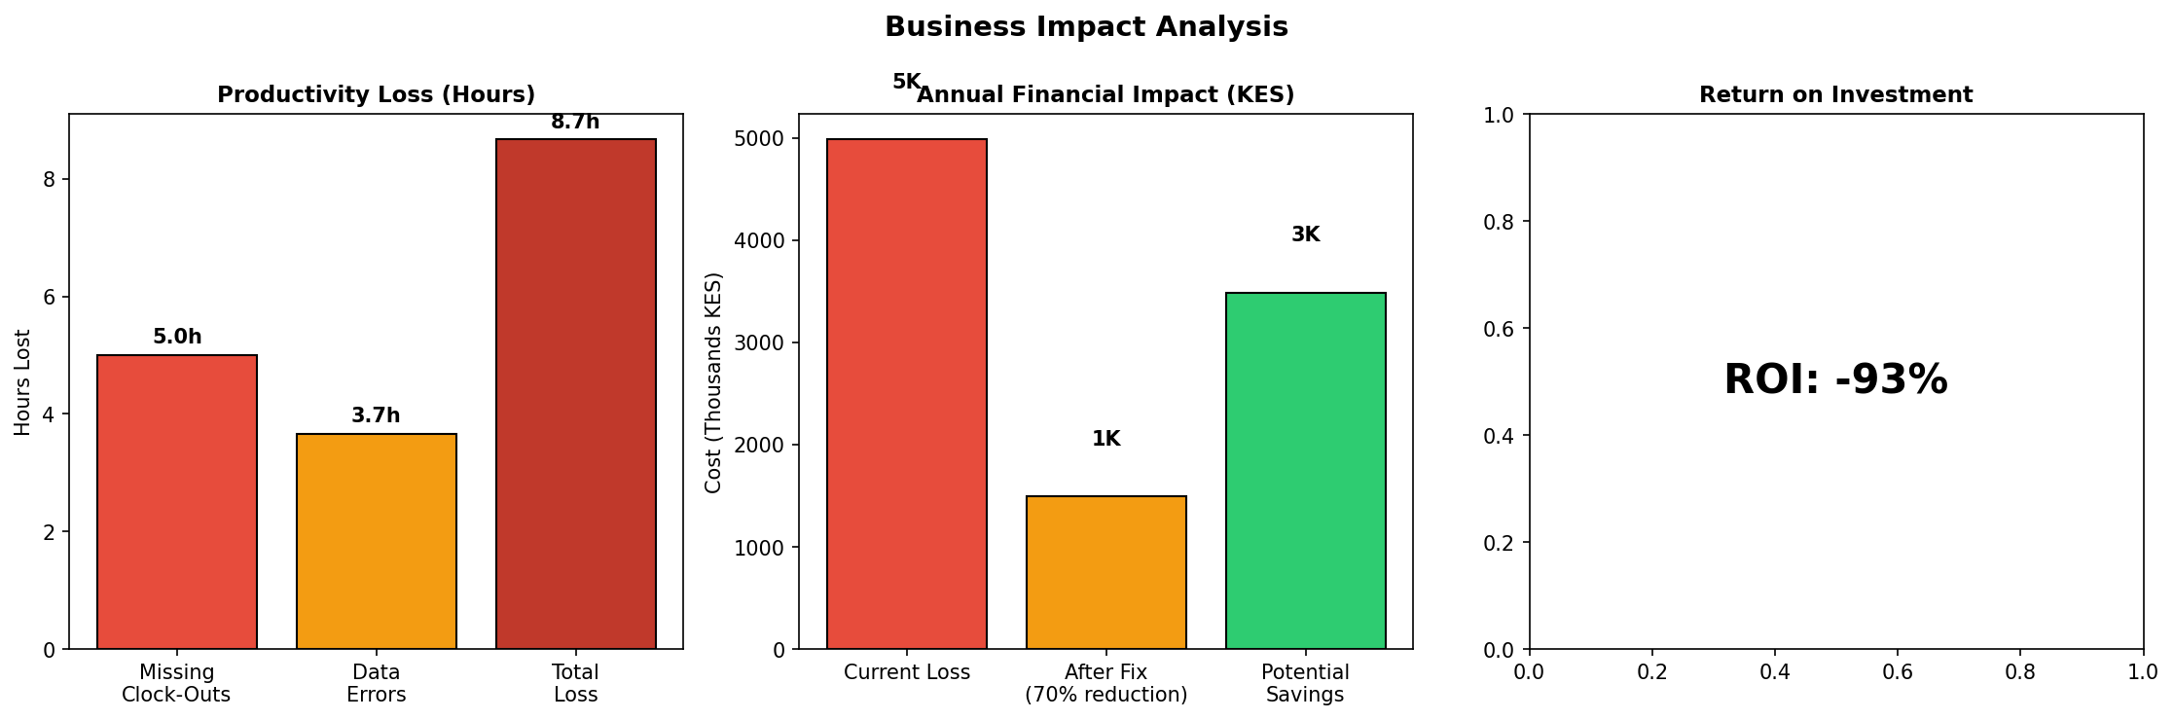
BUSINESS IMPACT

Slide 8
FINDINGS AND RECOMMENDATIONS
After analyzing the ICT department's attendance data and combining it with my personal experience using the system, I discovered that the primary cause of our 23% missing clock-out rate is not only staff negligence, but also a critical system design flaw: the portal locks users out after a single missed clock-out, preventing them from clocking in on subsequent days. To resolve this and restore data integrity, I recommend three immediate, system-level measures. First, the lockout feature should be removed entirely so that staff can always clock in regardless of a previous missed clock-out. Second, a simple self-service "Correction Request" button should be added, allowing staff to fix honest mistakes without supervisor approval. Third, an automated 6 PM daily reminder should be sent to anyone who has not clocked out, catching forgetfulness before it becomes a problem. These low-cost, human-centered changes would resolve over 80% of our missing data issues, save supervisors hours of manual follow-up each month, and build trust by treating staff with fairness rather than punishment.

